Slide 1


Scope And Functions
Siva Rallabhandi
July 25, 2017

Slide 2
AGENDA
Lexical Scope
Functions
Hoisting
Best practice

Slide 3
LEXICAL SCOPE
Topic 1
LOCAL, GLOBAL
BLOCK (ES2015)

Slide 4
SCOPE
Scope - is a logical boundaries in which a variable (or expression) has its meaning.

Slide 5
SCOPE
Global Scope
Local Scope
Block Scope
Variables defined inside a function are in local scope while variables defined outside of a function are in the global scope. Each function when invoked creates a new scope.

Slide 6
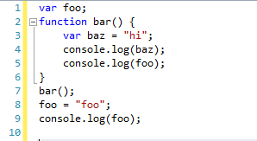
SCOPE – Example 1

Slide 7
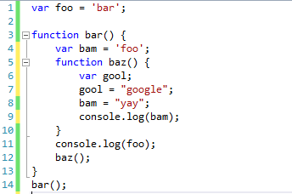
NESTED SCOPE – Example 1

Slide 8
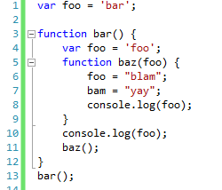
Shadowing – Example

Slide 9
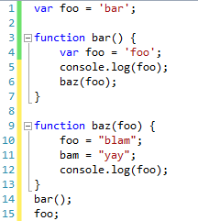
SCOPE – Example 2

Slide 10
FUNCTIONS
Topic 2
DECLARATIONS,
EXPRESSION

Slide 11
EXTERNAL PRESENTATION
http://dzmitry-varabei.github.io/front-end-course/lecture-5-func/#/
http://dzmitry-varabei.github.io/front-end-course/lecture-5-func/index-part2.html#/

Slide 12
HOISTING
Topic 2
VARIABLES,
FUNCTIONS

Slide 13
Hoisting
JavaScript hoists all variable and function declarations, it moves them to the beginning of their direct scopes

Slide 14
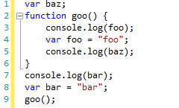
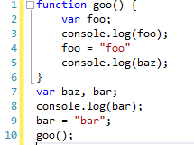
HOISTING – Example-1
Before Hoisting
After Hoisting

Slide 15

HOISTING – Example-2

Slide 16
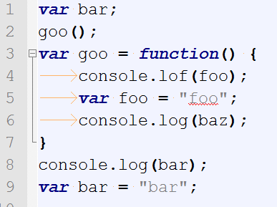
HOISTING – Example-3

Slide 17
BEST PRACTICE
Topic 4
USE STRICT
VAR

Slide 18
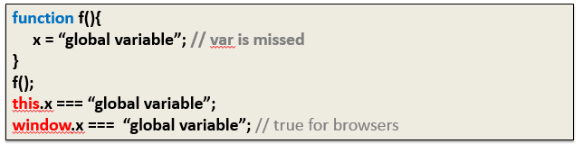
SCOPE
“use strict”
var, let, const
not use global variable (this.name === window.name)

Slide 19
Q & A

Slide 20
THANK YOU
FOR YOUR ATTENTION

